Slide 1
BME 590 Final Project
Ashwin Prakash
Aniruddh Marellapudi

Slide 2
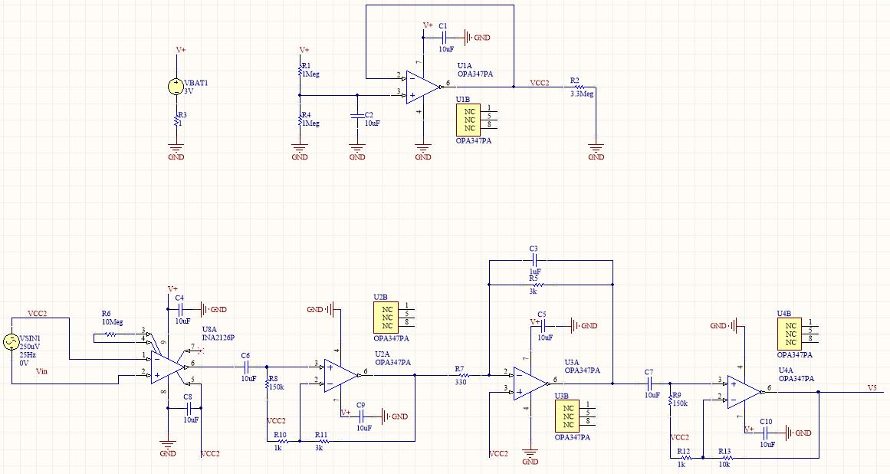
Full Schematic
Notes:
Note: your full schematic may not be readable like this. If so, please make sure you break it into readable pieces on the following slides.

Slide 3
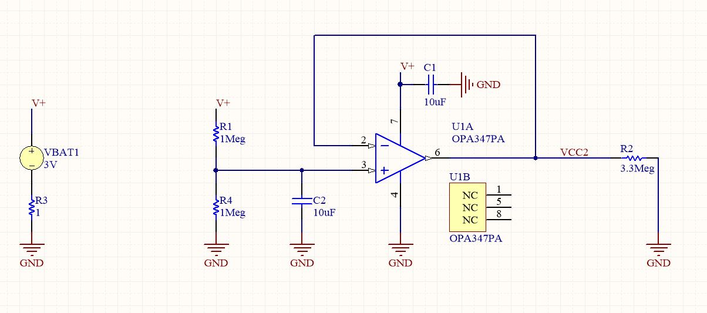
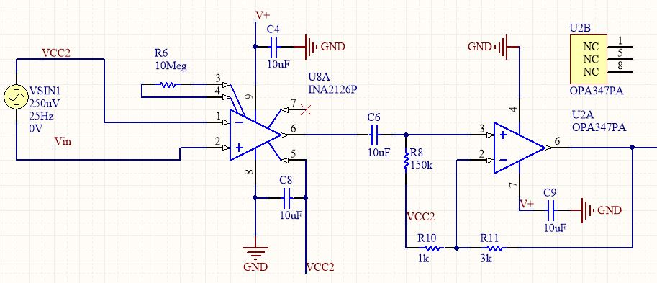

Slide 4
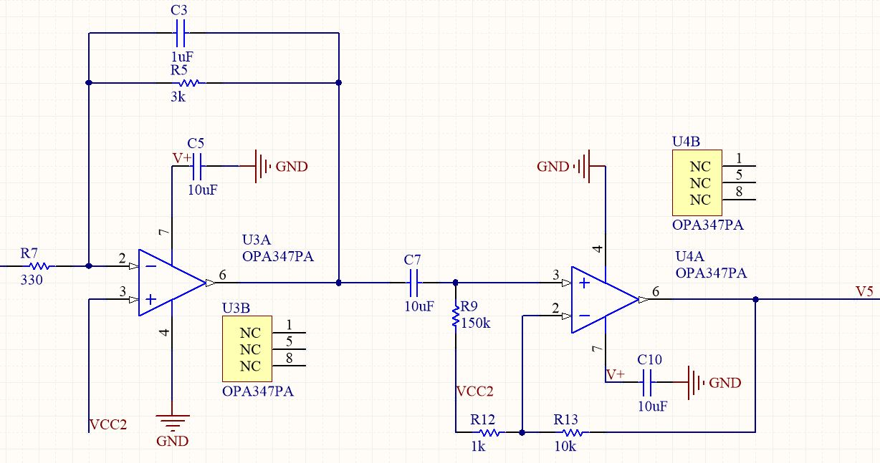
Schematic detail

Slide 5
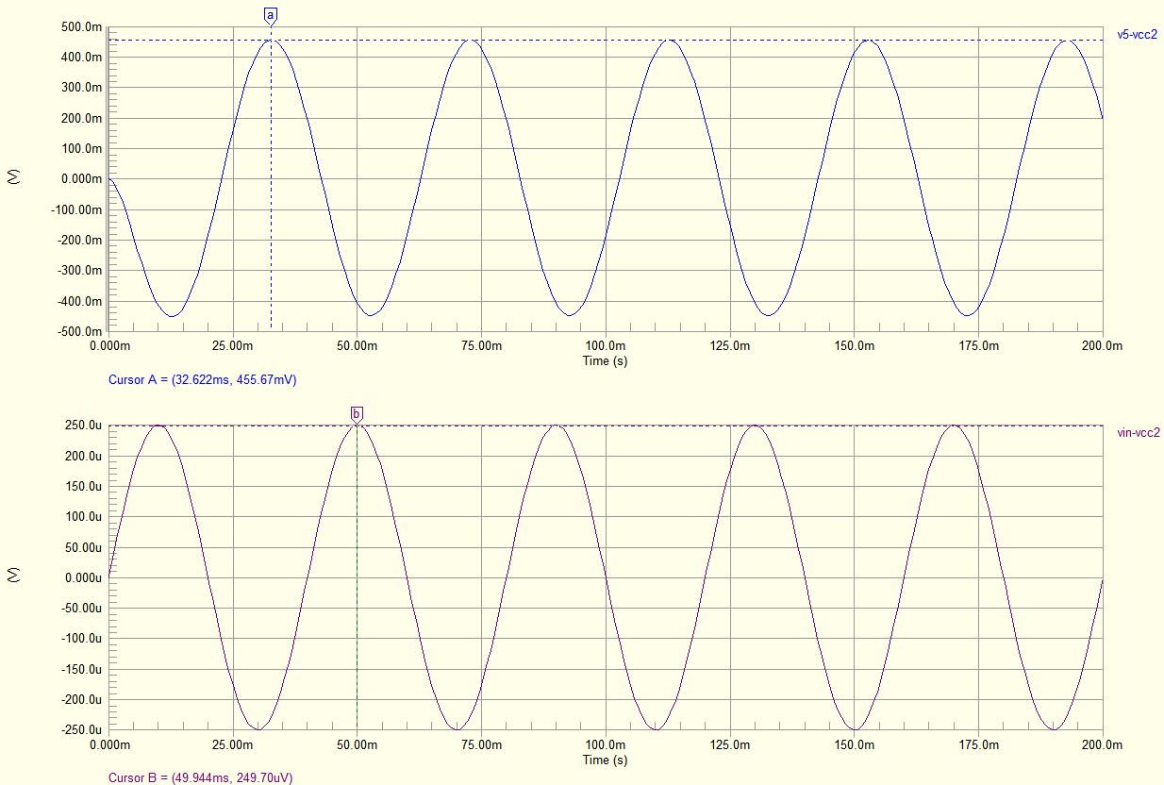
Simulation: Transient
Notes:
Illustrating gain. Signal source and output.

Slide 6
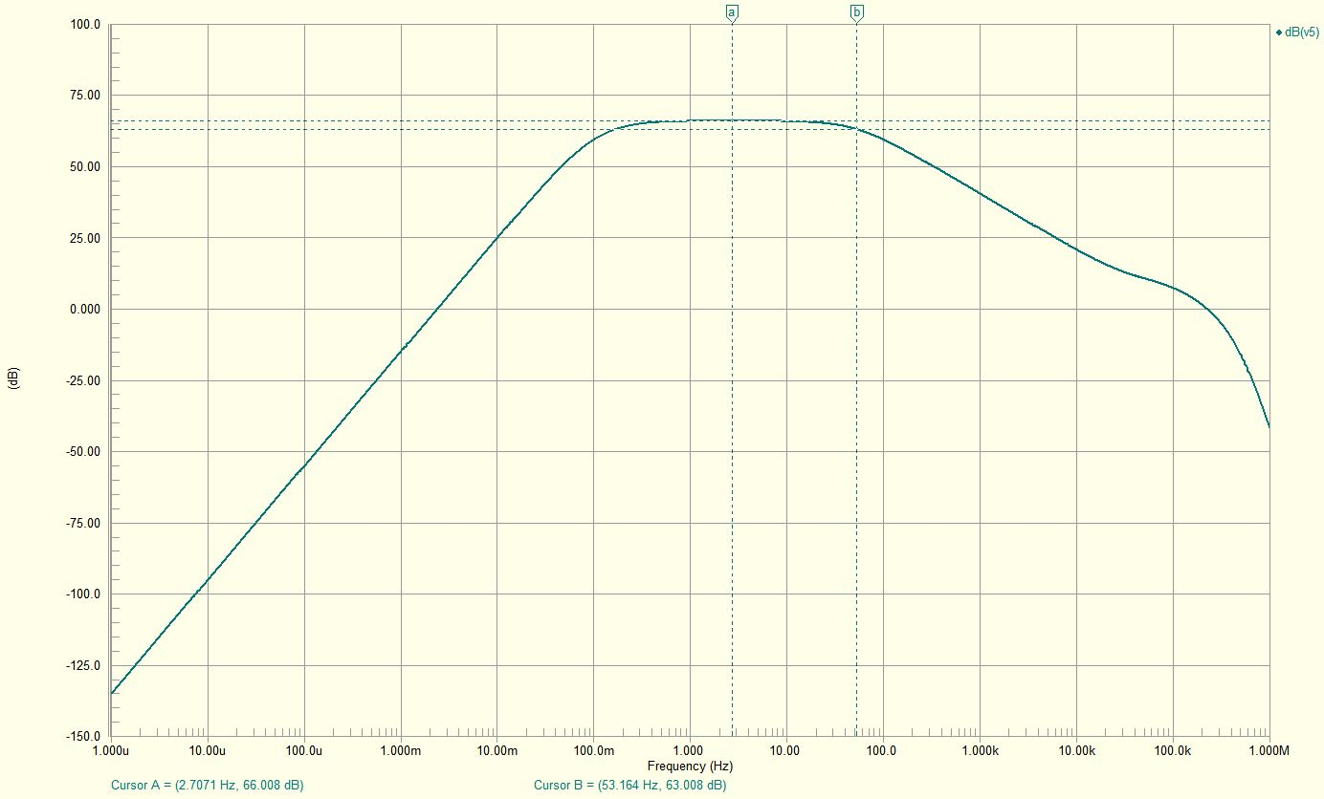
Simulation: Frequency Response
Notes:
Fill in your plot

Slide 7
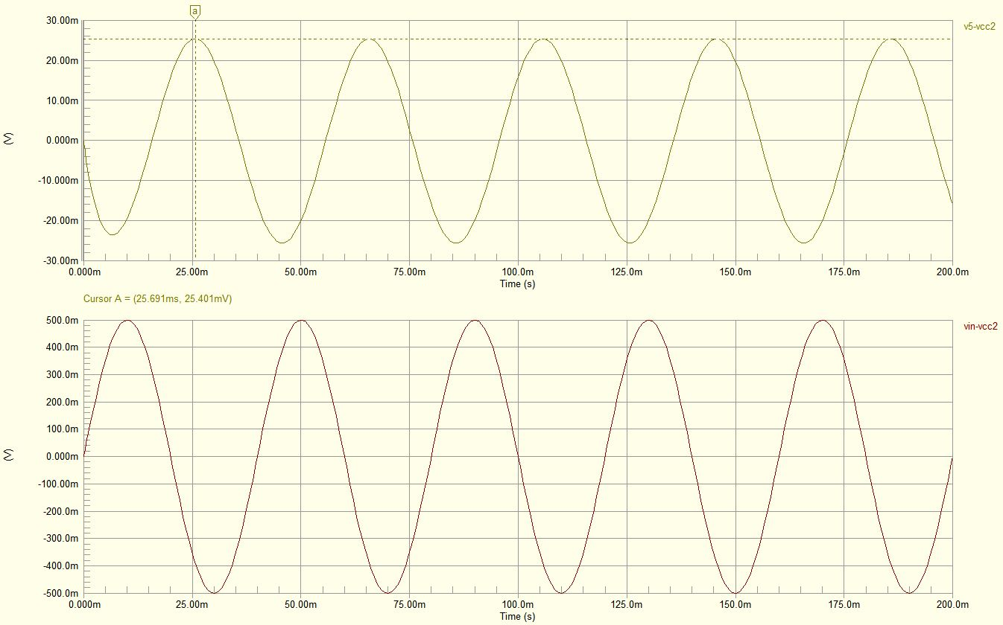
Simulation: Transient CMRR
Notes:
Illustrating gain. Signal source and output.

Slide 8
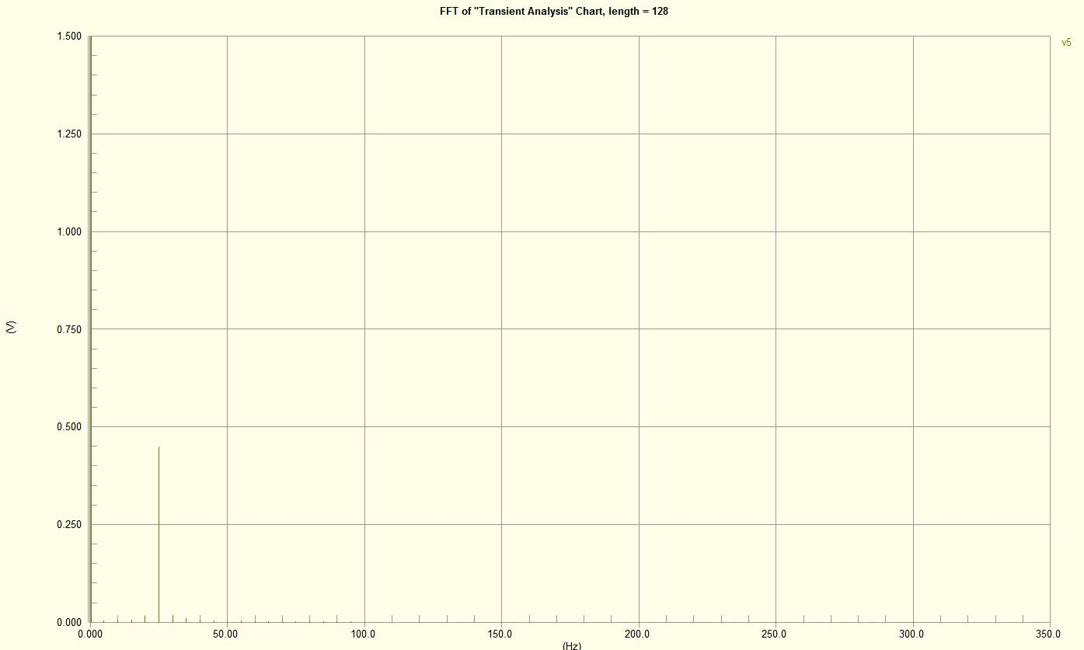
Simulation: Distortion
Notes:
Illustrating gain. Signal source and output.

Slide 9
Specification | Design Value | Simulation Result
Gain | 2003 | 1790
Noise | 1.03 µV RMS | 0.2644 µV RMS
Input voltage range | +/- 250 μV | +/- 250 μV
High pass filter -3 dB | 0.106 Hz | 0.106 Hz
Low pass filter -3 dB | 53.052 Hz | 53.164 Hz
Input offset range | +/- 150 | +/- 150
Power consumption | 20 µA/OPA, 175 µA/INA | 147 µA at 3V
CMRR (dB) | > 60 dB | 90.94 dB
Input Impedance | > 10 MΩ | 10 MΩ
Leakage Current | < 1 µA | 0.457 µA
Distortion | < 1%

Slide 10
Bill of Materials
Part | Description | Quantity
1uF | Capacitor | 2
10uF | Capacitor | 16
1 | Resistor | 1
330 | Resistor | 2
1k | Resistor | 4
3k | Resistor | 4
10k | Resistor | 2
150k | Resistor | 4
1Meg | Resistor | 2
3.3Meg | Resistor | 1
10Meg | Resistor | 2
OPA347PA | MicroPower, Operational Amplifier | 7
INA2126P | Micropower Instrumentation Amplifier | 1
SRDA3.3-4DR2G | ESD Protection | 1
CR123A | CR123A Battery | 1
BCR123A | Battery Housing | 1
TE Connectivity 1-1337543-0 | BNC Connector | 2
36619 1.5mm Touchproof EEG Connectors | PCB Electrode Jack | 4
5cm x 10cm PCB | Estimate from Fusion PCB | 100
 |  | 25.0404

